Slide 1



2021M

Slide 2



QUESTION # 1 – RAISE YOUR HAND TO ANSWER
QUESTION # 2 – CLAP TO ANSWER

Slide 3
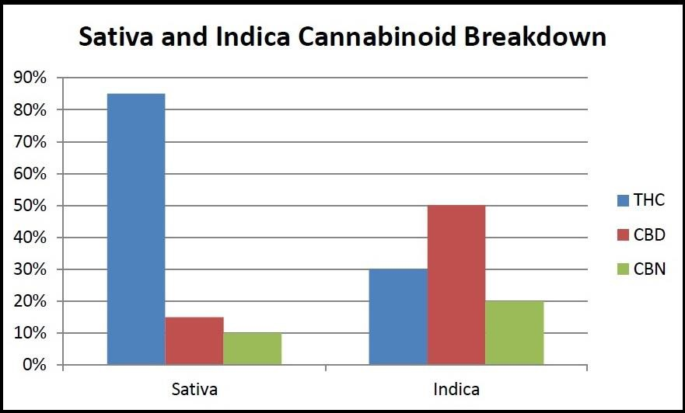
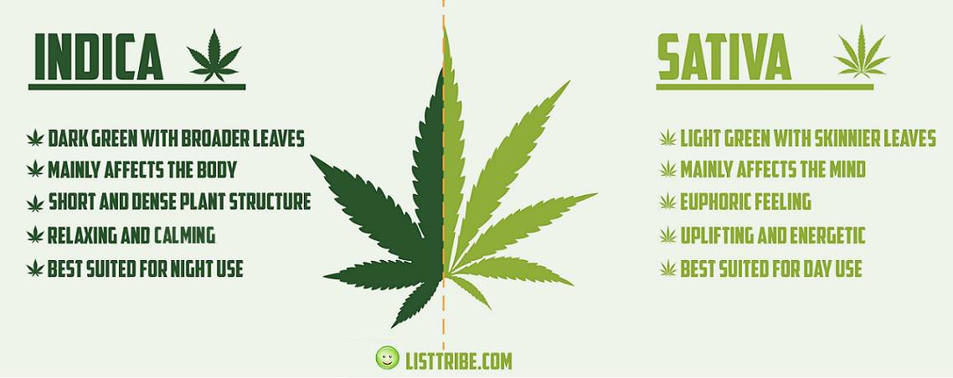
TRADITIONAL LEAFY PLANT WITH 7 TO 9 LEAVES. THERE ARE 3 TYPES.
TETRAHYDROCANNABINOL -- STIMULANT
CANNABIDIOL -- HEMP -- TONES DOWN NEGATIVE EFFECTS OF THC
-- NON-INTOXICATING -- <0.3% THC
CANNABINOL -- GENTLE SEDATIVE -- SLEEP

Slide 4
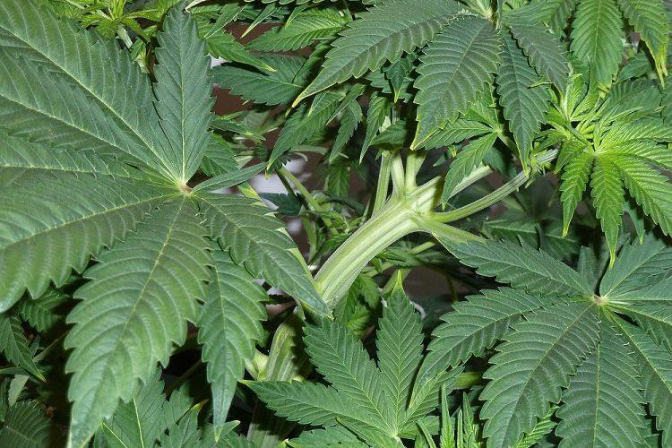
INDICA (CALMING)
WIDE DARK GREEN LEAVES.
INDICA IS SHORT & DENSELY BRANCHED – AVERAGE 2 TO 4 FEET
6 TO 8 WEEKS TO MATURE
HAS A STRONG SMELL, EITHER SWEET OUR SOUR HAS A HIGHER CBD:THC RATIO
IT PROVIDES A RELAXING “BODY” HIGH ASSOCIATED WITH CALMNESS AND SLEEP
USED TO RELIEVE PAIN, NAUSEA, SPASMS AND TO INDUCE SLEEP
MOST OFTEN USED IN THE EVENING

Slide 5
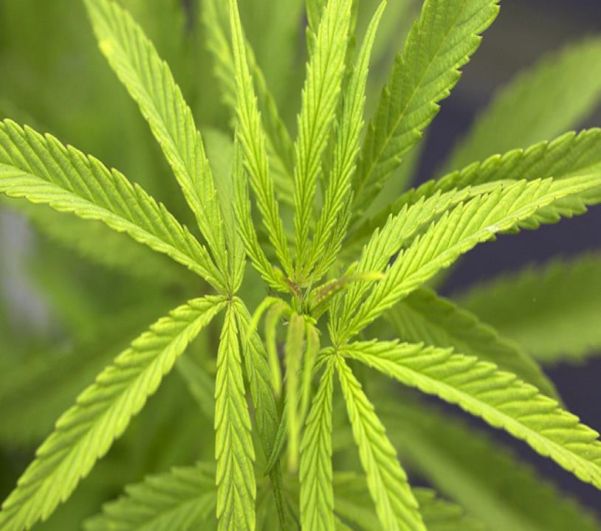
SATIVA (HALLUCINOGEN)
ELONGATED, LIGHT GREEN LEAVES.
SATIVA IS TALL – AVERAGE ABOUT 6 FEET TALL BUT CAN REACH 20 FEET 3 TO 4 MONTHS TO MATURE
HAS A GRASSY SMELL
HAS A HIGHER THC:CBD RATIO
IT PROVIDES AN ENERGETIC “CEREBRAL” HIGH USED TO STIMULATE HUNGER, ENERGY AND FOCUS MOST OFTEN USED DURING THE DAY

Slide 6
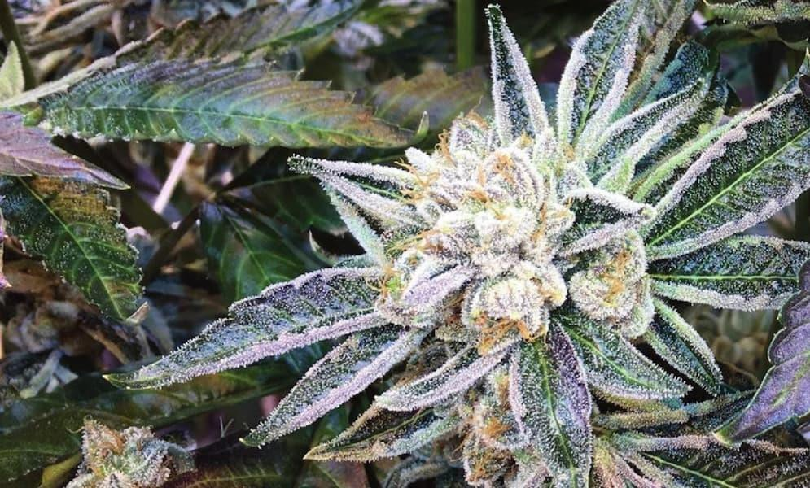
HYBRIDS (COMBINES EFFECTS FROM BOTH STRAINS)
TAKES ON CHARACTERISTICS OF PARENT STRAIN VARIED LEAFLETS AND SHORTER IN STATURE
6 TO 8 WEEKS TO MATURE
CBD:THC RATIO / THC:CBD RATIO CAN BE MINIPULATED TO ACHIEVE DESIRED EFFECTS
CAN CREATE A MIXTURE OF “BODY” AND “CEREBRAL” EFFECTS
RUDERALIS IS ONE HYBRID USED TO CREATE S SATIVA OR S INDICA HYBRIDS TO GET DESIRED TRAITS

Slide 7
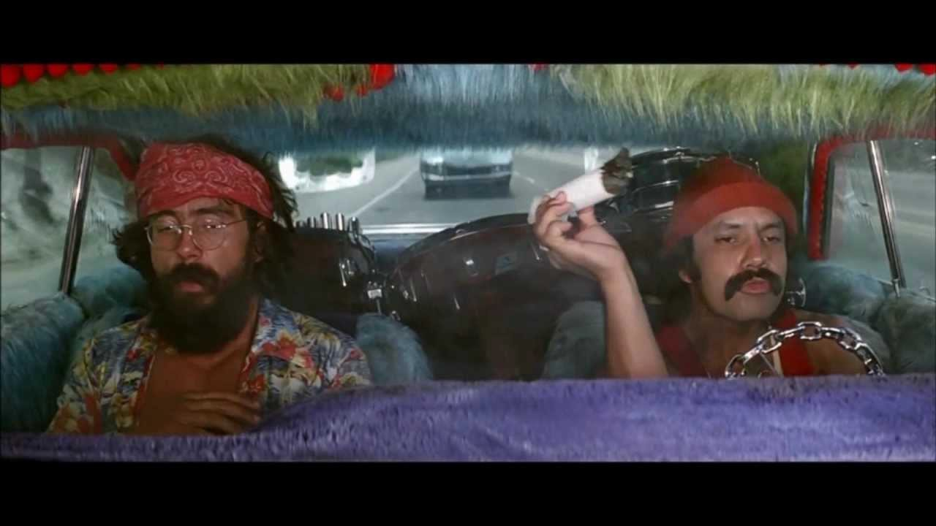
1969 7% THC

Slide 8
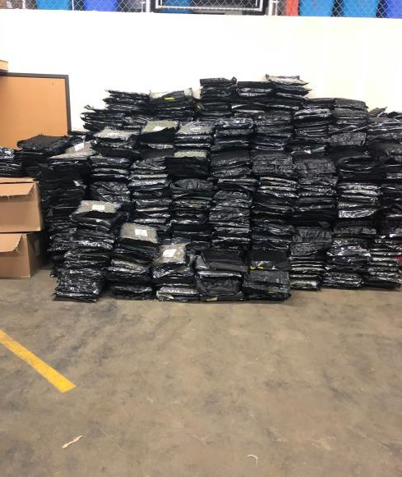
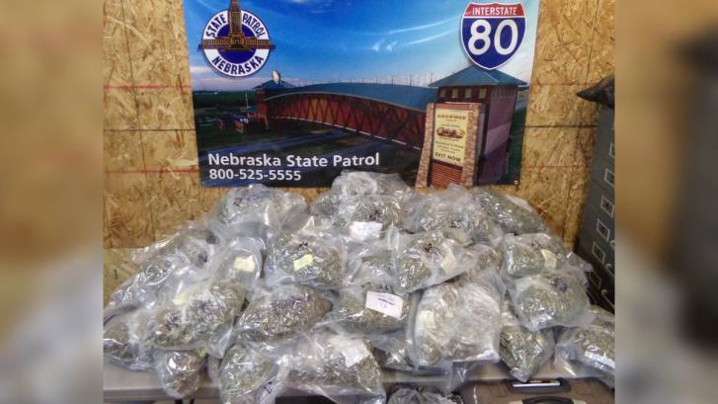
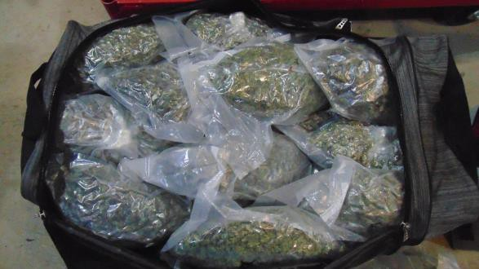
49 POUNDS NEAR KEARNEY
1745 POUNDS + 60 POUNDS
OF THC
IN DAWSON COUNTY PACKAGED AS COFFEE
60 POUNDS
NEAR BRADSHAW
TODAY – 21% TO 28% THC

Slide 9
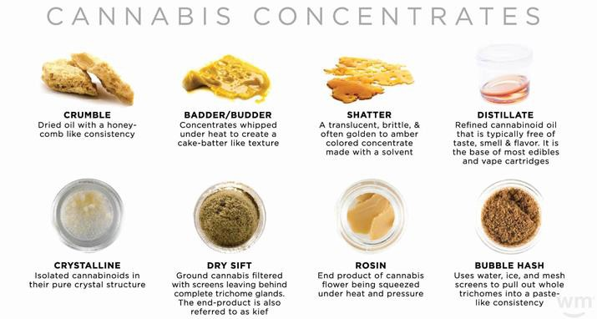
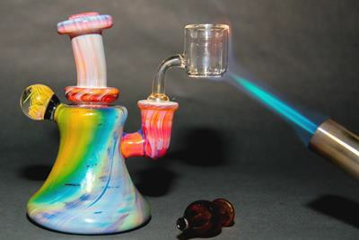
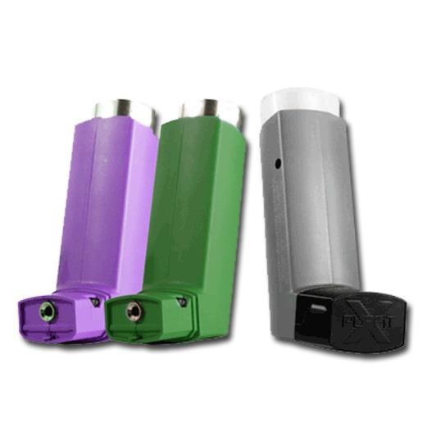
BUTANE REFINED – WAX, SHATTER, DABS, ETC.
98% THC

Slide 10
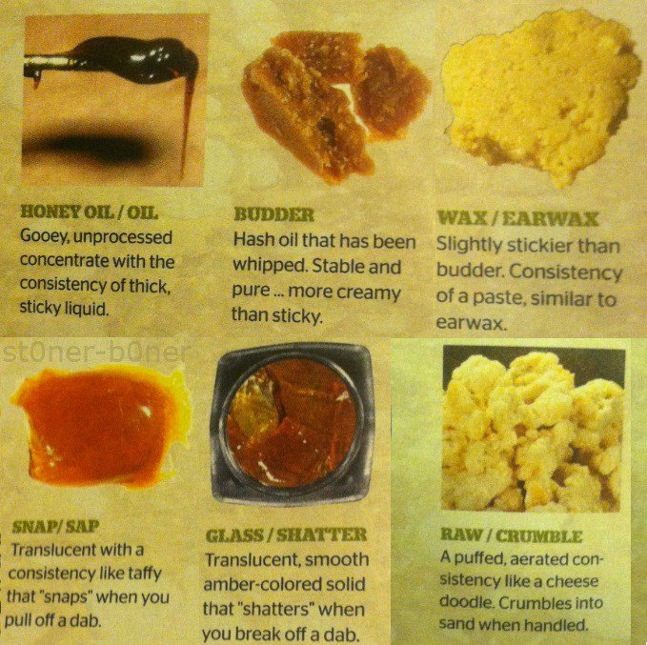
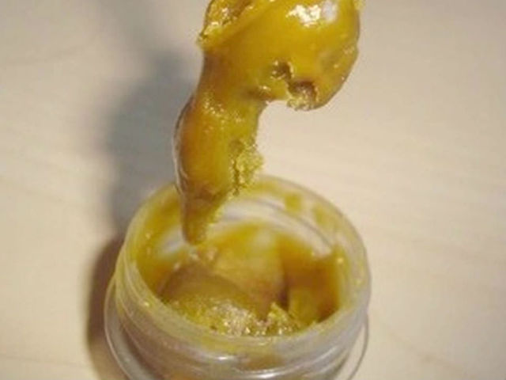
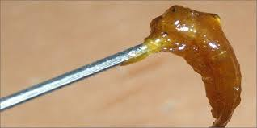
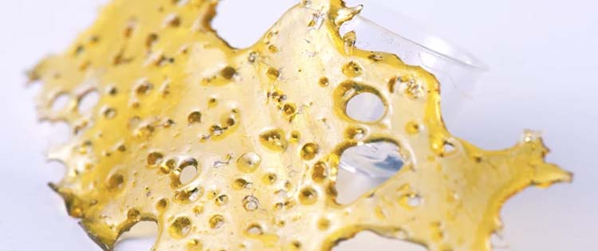
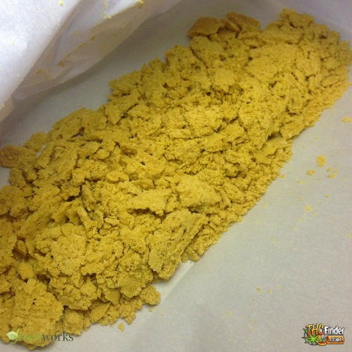
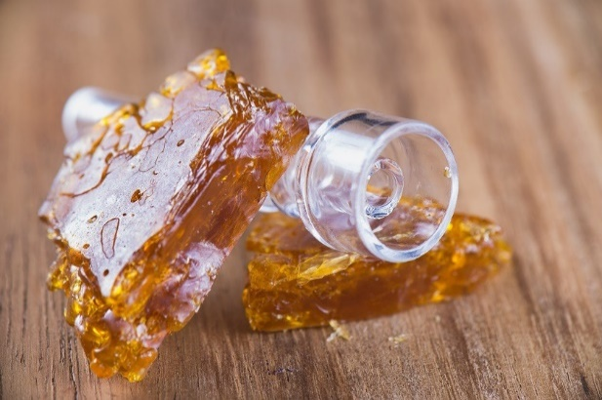

Slide 11
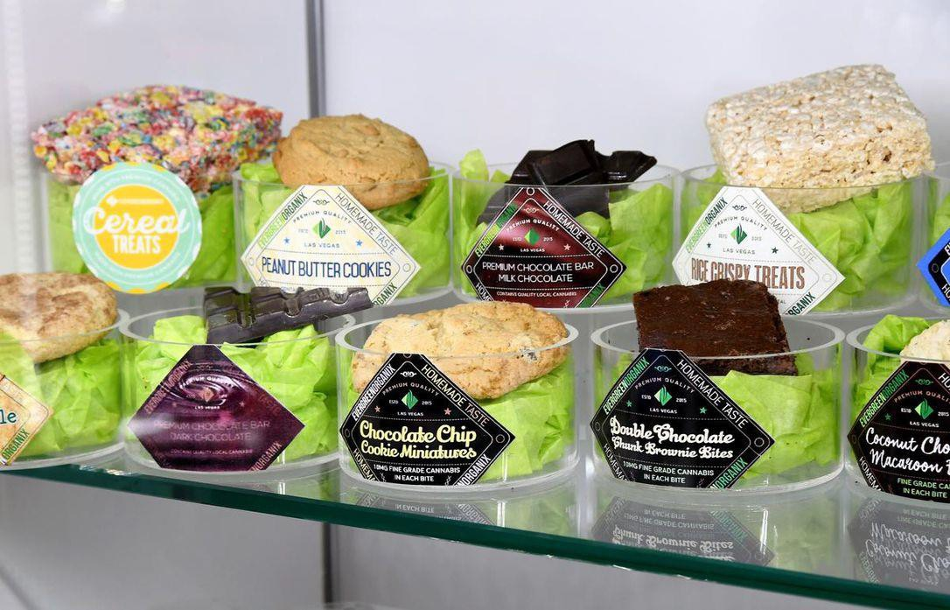
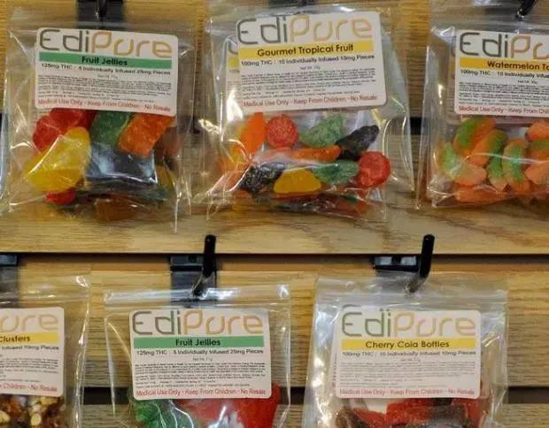
EDIBLES (DISTILLATE CANNABINOID OIL ADDED TO FOOD ITEMS)
80% THC

Slide 12
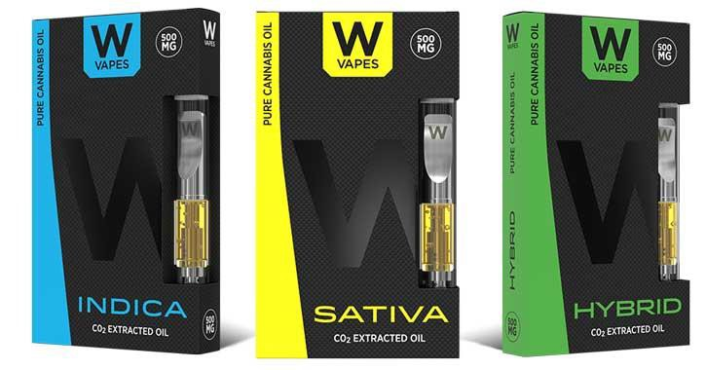
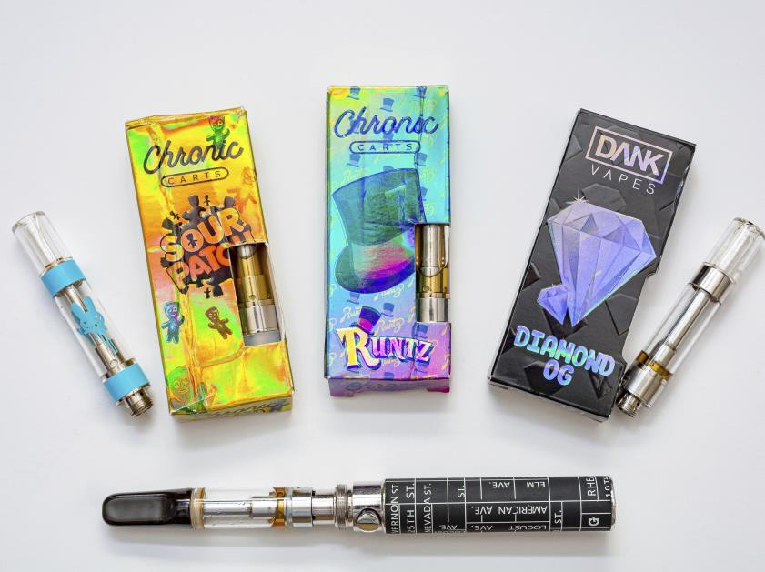
VAPOR OILS (CANNABINOID DISTILLATES PLACED IN VAPING DEVICES)
98% THC

Slide 13
SYMPTOMS OF MARIJUANA USE
DEMINISHED INHIBITIONS
SCHIZOPHRENIA, PARANOIA, DEPRESSION
POOR PERCEPTION OF TIME AND DISTANCE
DISORIENTATION
BODY TREMORS
EYELID TREMORS
DIALATED PUPILS
MARKED REDNESS OF EYES – BOTH EYES
MARIJUANA ODOR ON BREATH OR CLOTHING
DEBRIS IN MOUTH OR ON LIPS, GREEN TONGUE OR BLISTERED TONGUE

Slide 14
SIGNS OF OVERDOSE
EXTREME AGITATION AND ANXIETY
RACING HEARTBEAT
HIGHER THAN NORMAL BLOOD PRESSURE
MUSCLE SPASMS, SEIZURES AND TREMORS
HALLUCINATIONS AND PSYCOTIC EPISODES
THOUGHTS OF SUICIDE OR OTHER HARMFUL THOUGHTS OR ACTIONS –
THEY HAVE MANY MORE VIOLENT OUTBURSTS THAN IN THE PAST

Slide 15
www.nebraskaelks.org
Click down arrow at right of Drug Awareness 4 Pages of Information About Our Program SMOSH Videos are in Youth Information Page

Slide 16
