Slide 1



2021M

Slide 2



QUESTION # 1 – RAISE YOUR HAND TO ANSWER
QUESTION # 2 – CLAP TO ANSWER

Slide 3
What are Opioids?
Opioids are a class of drugs that include the illegal
drug heroin, synthetic opioids such as fentanyl, and pain relievers available legally by prescription, such as oxycodone (OxyContin®), hydrocodone (Vicodin®), codeine, morphine, and many others.

Slide 4
All opioids are chemically related and interact with opioid receptors on nerve cells in the body and brain. Opioid pain relievers are generally safe when taken for a short time and as prescribed by a doctor, but because they produce euphoria in addition to pain relief, they can be misused (taken in a different way or in a larger quantity than prescribed or taken without a doctor’s prescription). Regular use— even as prescribed by a doctor—can lead to dependence and, when misused, opioid pain relievers can lead to addiction, overdose incidents, and deaths.

Slide 5
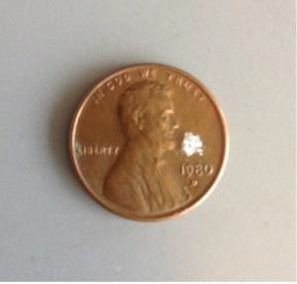
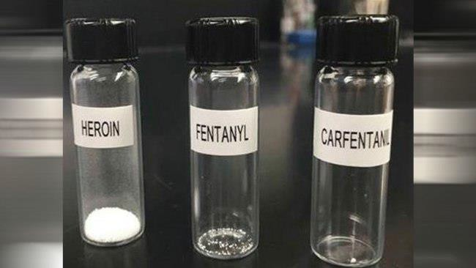
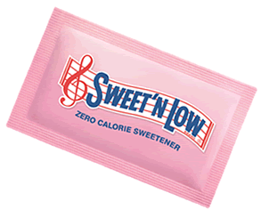
For your visual comprehension of the lethal (your dead) dose of heroin, fentanyl and carfentanyl, here are a couple pictures to burn into your mind.
2021M

Slide 6
So, how are our kids getting their hands on Opioids?
Believe it or not, from you, another relative or from a friend.
How is that possible? We watch them really close.
How often have you heard, “Our kids would never…”
In an independent study, 4 out of 5 heroine users
questioned said they got their first taste of drugs
from the family medicine cabinet.

Slide 7
Our society is at epidemic levels of legal prescription drug use. Opioids are so easy to find in almost every family medicine cabinet these days. For so many, stress and depression are a normal part of life, and it is fueling this epidemic and enticing our youth to experiment. The free high eventually ends when the medicine cabinet runs dry, but for a few extra dollars and the right connections, the new journey into heroin and other drugs can begin. Even with the new government restrictions on opioid dispensing, people are still figuring out ways to get their hands on opioids.

Slide 8
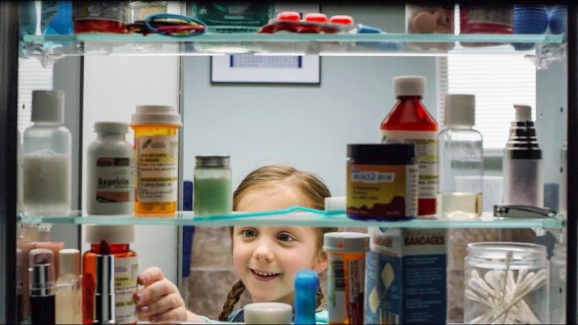
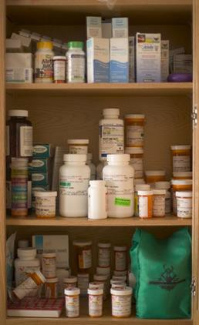
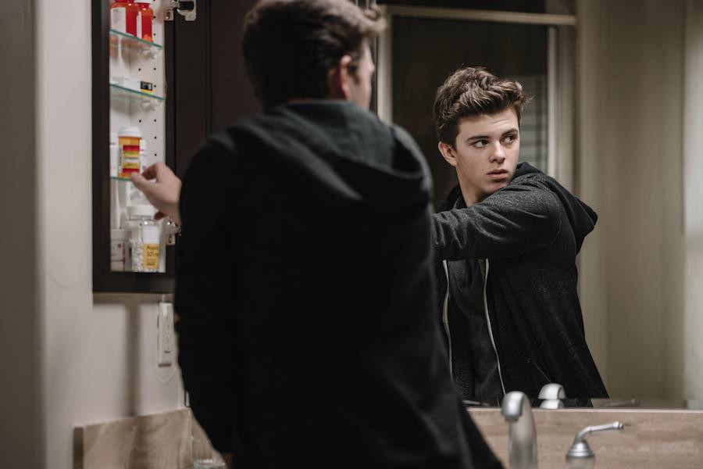
Accidental Overdose - Looks like pretty colored candy to kids.
Introduction and addiction to opioids – Easy access for use or to sell to others.
This well stocked medicine cabinet has the potential to produce two very heart wrenching outcomes.

Slide 9
Either one of those scenarios will change your life forever!
But there is a simple solution…
1. The DEA has two takeback days every year. One in April and a second in October. This is a great opportunity to get rid of those unneeded drugs to make your medicine cabinet safe again.

Slide 10
2. The second option is to go to:
nebraskameds.org
On the home page on the right side, you can put in your city or zip code to search for pharmacies within a 25- mile radius that will take your unneeded drugs, no
questions asked.

Slide 11
If you are interested in learning more about prescription drug abuse, a good place to start is: doseofreality.nebraska.gov
The information shared from their “Get the Facts” tab will
get you on your way to understanding the dangers of prescription pain killers.

Slide 12
A Few Quick Facts
Over 289 million prescriptions for painkillers are written each year in the United States.
From June 2019 to May 2020 there were 81,000 Drug Overdose Deaths
Prescription pain killers kill more people than all other drugs combined.
Every 2 days, someone in Nebraska dies of an overdose.
On average, a new synthetic or analogue drug is introduced every week.

Slide 13
A few years ago, then Acting Director Chuck Rosenberg of the DEA made this comment to all attending our annual training session:
“It is IMPOSSIBLE to put a dent in the drug epidemic we are experiencing simply by catching and convicting. The only way to slow the epidemic is to educate as many people as possible. We need to start young and continue until they grow weary of our talking. Statistics show that if a person can make it to their mid 20’s and haven’t tried drugs, it is very likely that they never will.”

Slide 14
WE NEED YOUR HELP!!

Slide 15
www.nebraskaelks.org
Click down arrow at right of Drug Awareness 4 Pages of Information About Our Program SMOSH Videos are in Youth Information Page

Slide 16
