Slide 1




2021V

Slide 2



QUESTION # 1 – RAISE YOUR HAND TO ANSWER
QUESTION # 2 – CLAP TO ANSWER

Slide 3
NICOTINE, SMOKING & VAPING
NICOTINE IS A POISON - INSECTICIDE - ONE OF THE FEW CHEMICALS THAT KILL COCKROACHES – DESTROYS THE LINK BETWEEN ORGANS
60
59
40-45
59
58
425° - 450°
NICOTINE FREE – MANY VAPES ARE BEING OFFERED AS NICOTINE FREE
<19 CIGARETTES 57
SECOND-HAND SMOKE
THIRD-HAND SMOKE
ADDICTION SIGNS
VAPING IN CLASS
TAKES MANY BATHROOM BREAKS
GOT THEIR VAPE ILLEGALLY
HOW SOON IN THE MORNING
DENIAL ANSWERS

Slide 4

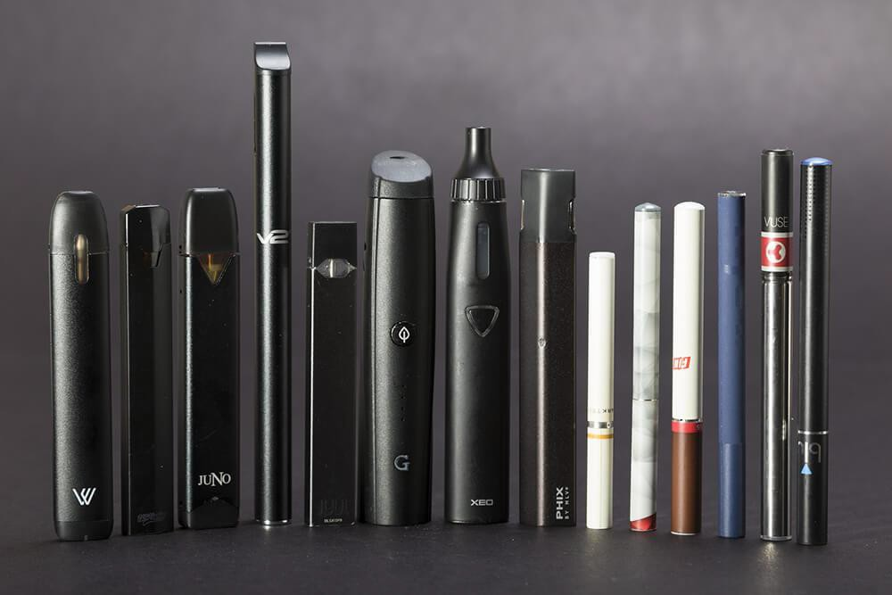

Slide 5
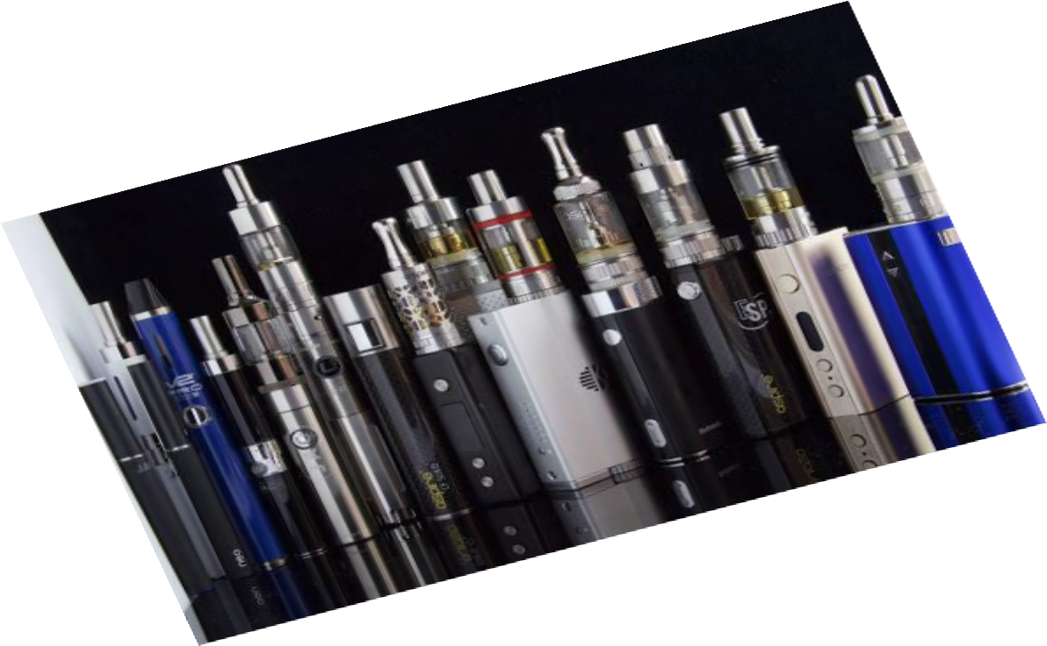
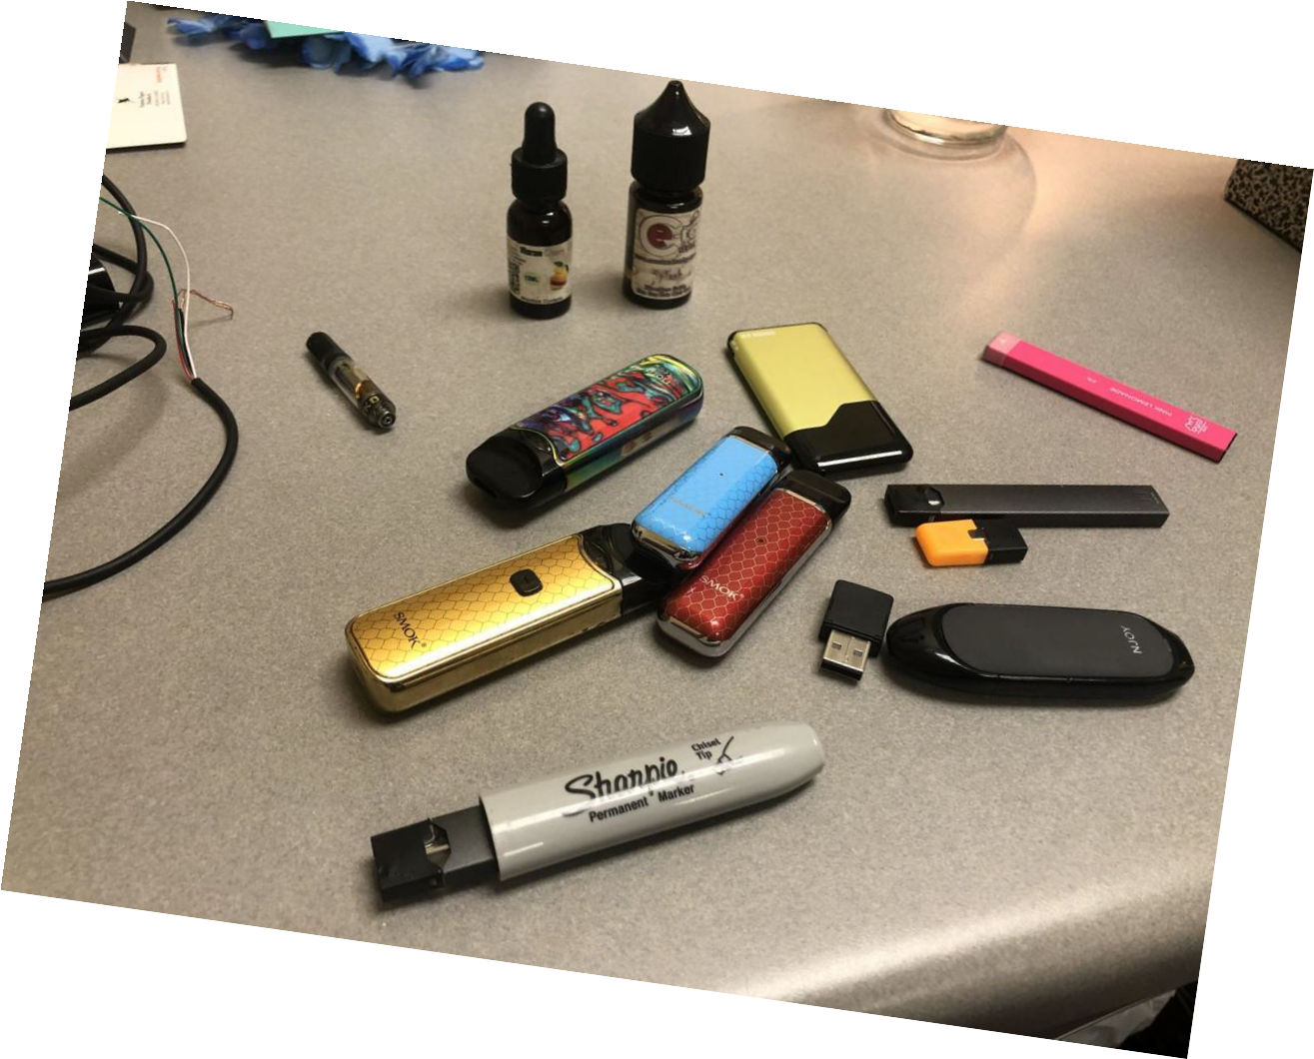

Slide 6
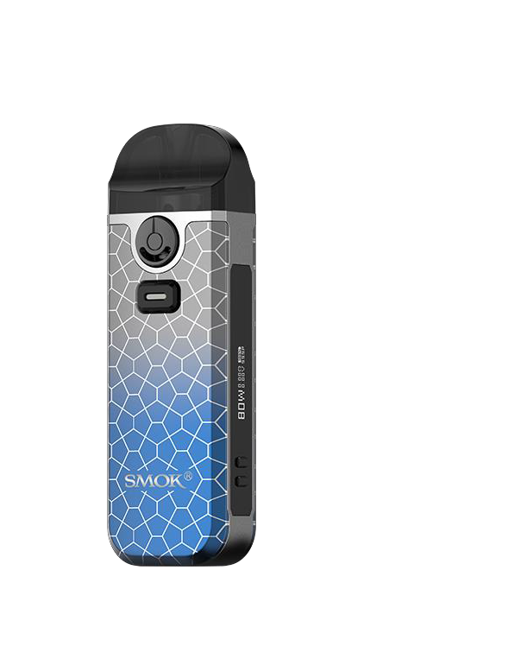

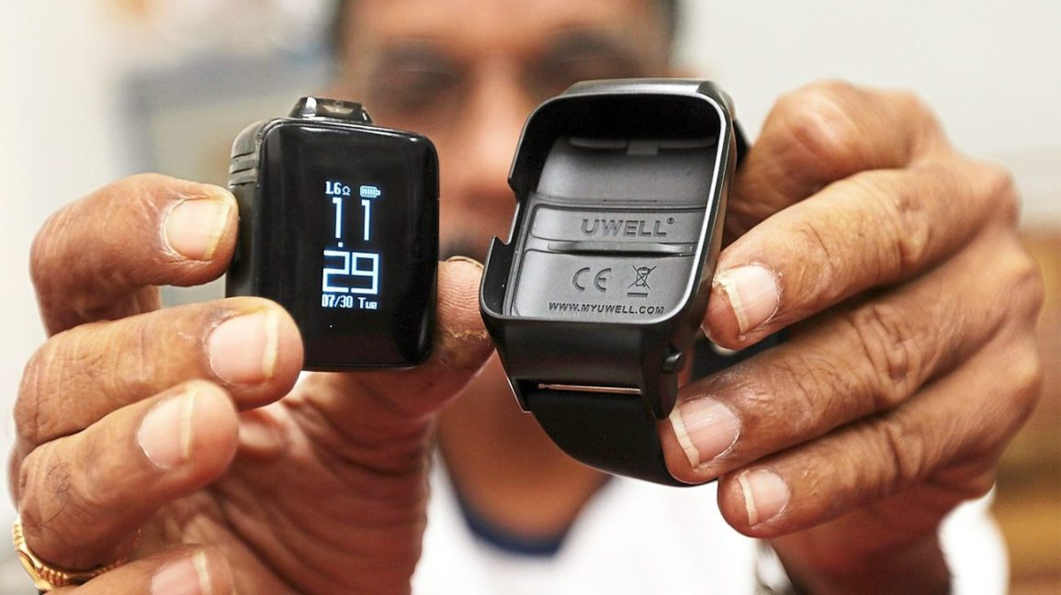

Slide 7


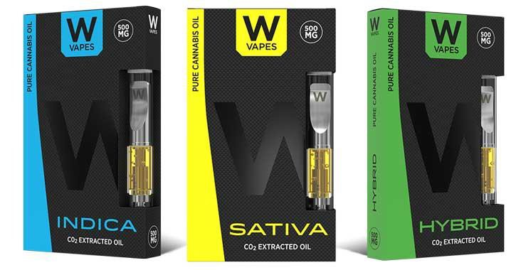
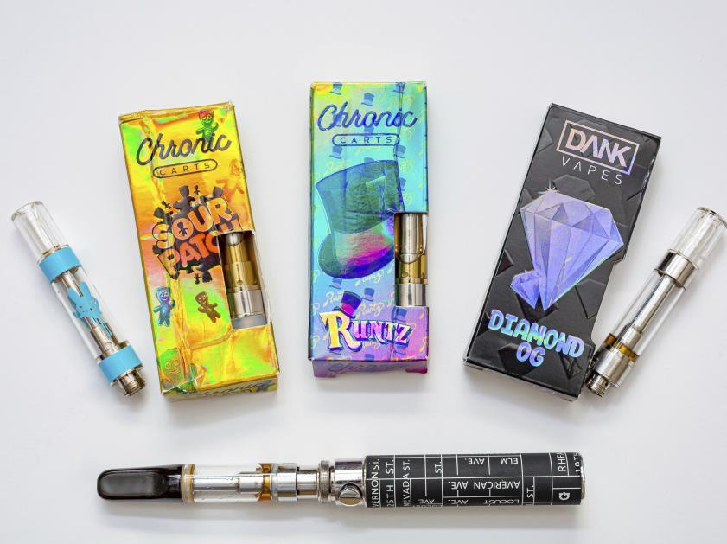





98% THC

Slide 8





Slide 9
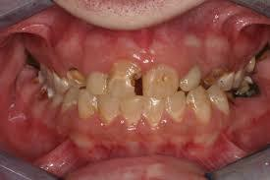
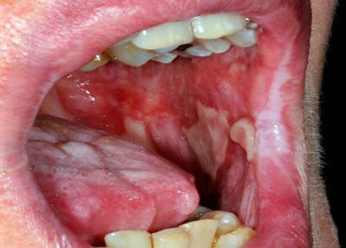
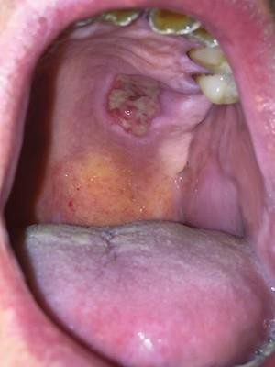

Slide 10
LIQUIDS USED TO CREATE VAPOR
Formaldehyde
Acrolein – A Herbicide
Diacetyl – Known to Causes Popcorn Lung
Propylene Glycol – Food Grade Antifreeze

Slide 11
www.nebraskaelks.org
Click down arrow at right of Drug Awareness
4 Pages of Information About Our Program

Slide 12
